Slide 1
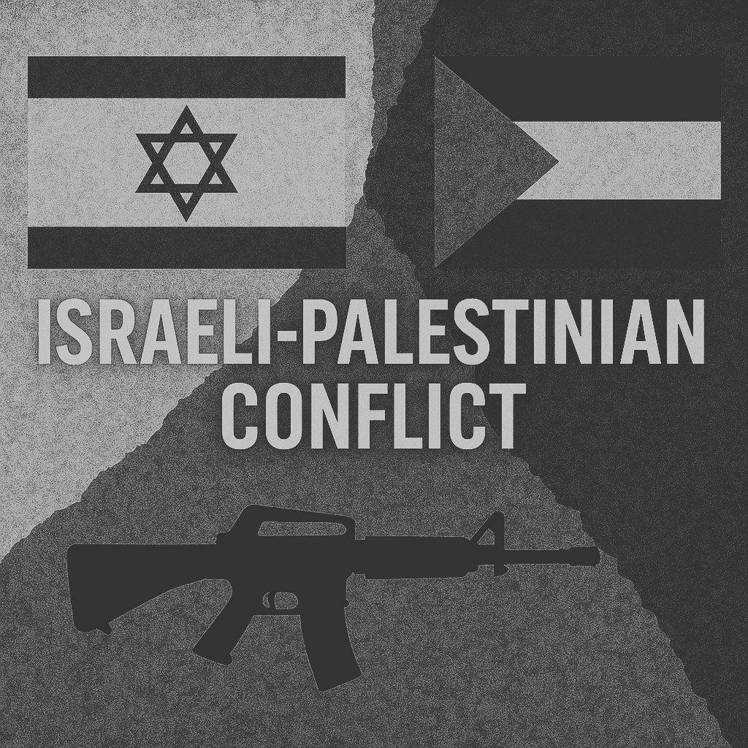

Voices in Conflict: Temporal Topic and Sentiment Analysis of Reddit Discourse on the Israel-Palestine War
IS7650 SOCIAL MEDIA ANALYSIS
Group 6
Zhao Ziqing - G2404735C - ziqing004@e.ntu.edu.sg
Chen Ziqing - G2404783K- w240005@e.ntu.edu.sg
April 07, 2025

Slide 2
CONTENT
IS7650 SOCIAL MEDIA ANALYSIS
INTRODUCTION
RELATED WORK
METHODOLOGY
FINDINGS
Q&A
Group 6
Zhao Ziqing - G2404735C - ziqing004@e.ntu.edu.sg
Chen Ziqing - G2404783K- w240005@e.ntu.edu.sg
April 07, 2025

Slide 3
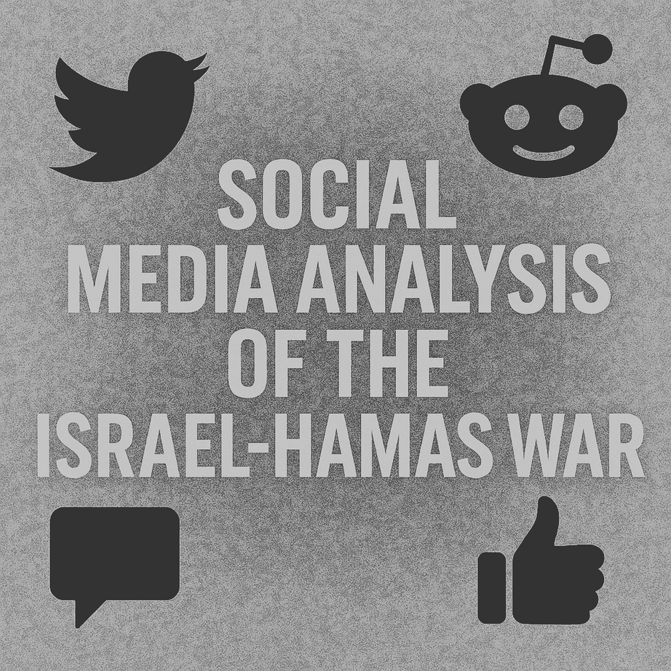
INTRODUCTION
Reddit as a Platform for Public Opinion
With the growing influence of social media platforms on global public discourse, platforms like Reddit have become important channels for disseminating user opinions, expressing emotions, and exchanging information during major geopolitical conflicts.
IS7650 SOCIAL MEDIA ANALYSIS
Social Media Reactions
The renewed outbreak of the Israel-Hamas war in 2023 not only led to a major humanitarian crisis, but also sparked widespread discussions on social media platforms regarding the nature of the war, humanitarian issues, and political stances.
April 07, 2025
PAGE
01

Slide 4
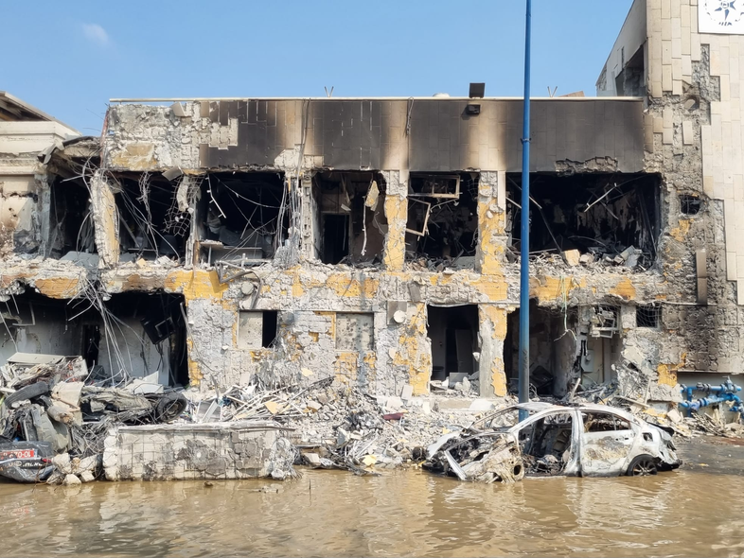
INTRODUCTION
IS7650 SOCIAL MEDIA ANALYSIS
Key Dates & Events
Content Goals
Opportunities
Social media can serve as a sensor of public sentiment and emotional fluctuations.
Existing research on war-related discourse in social media primarily focuses on platforms like Twitter and Facebook, while Reddit — characterized by long-form content and a strong discussion culture — remains underexplored.
Investigating topic dynamics and sentiment can help reveal how public opinion evolves during periods of conflict.
April 07, 2025
PAGE
02

Slide 5
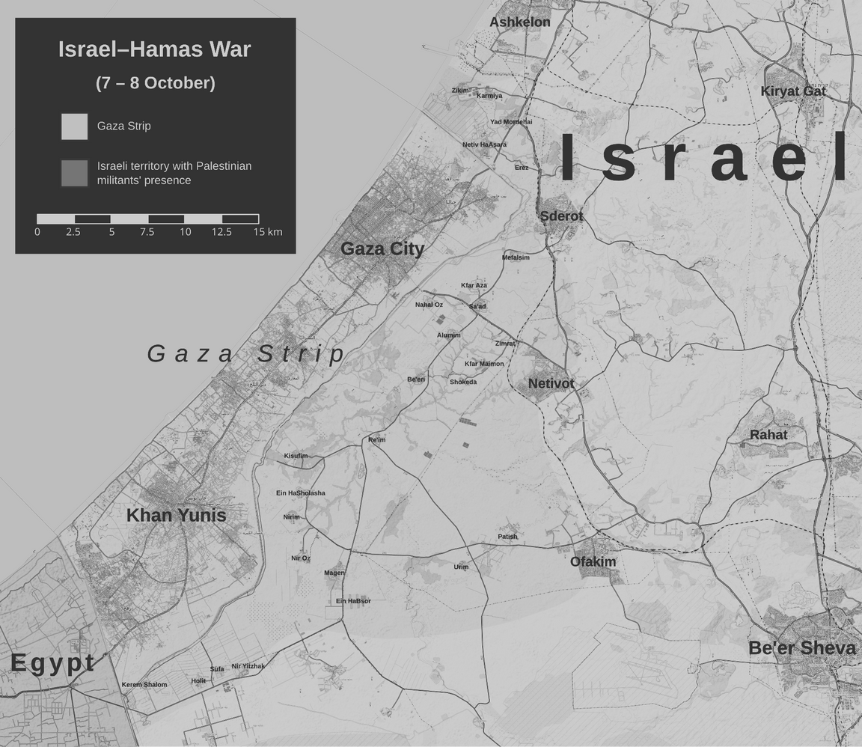
BACKGROUND
Why Reddit?
Reddit enables anonymous, long-form communication, fostering a deeper environment for political and controversial discussions.
IS7650 SOCIAL MEDIA ANALYSIS
Why War-Time Information Flow?
During conflicts, information spreads rapidly and tends to be highly polarized, often triggering emotional responses.
Computational Challenges of Large-Scale Texts
Long-form social media texts often involve massive volumes of data. This imposes significant demands on data preprocessing and computational resources required.
April 07, 2025
PAGE
03

Slide 6
RQ1:
What are the main topics discussed by Reddit users during the Israel-Hamas war?
How do these topics evolve across different time periods?
IS7650 SOCIAL MEDIA ANALYSIS
RQ2:
What are the emotional trends in Reddit discussions about the conflict, and how do these expressions of sentiment vary across different subreddits?
April 07, 2025
PAGE
04

Slide 7
Social Media and Conflict
RELATED WORK
Social media has revolutionized conflict communication, democratizing information and shaping narratives. It alters traditional media coverage, focusing more on human suffering and less on political narratives (Hatte et al., 2021). It also enables strategic dissemination by political and military figures and exacerbates domestic conflicts and polarization due to misinformation (Hunter & Biglaiser, 2022; Shamsi, 2023). This dual role highlights its complex impact on both global and domestic levels.
Reddit Analysis
Social media influences information dissemination, with platforms like Reddit highlighting user interactions and emotions through advanced analytics. Sentiment analysis, particularly with models like VADER, captures user emotions effectively, suited to the informal language of social media (Silva et al., 2024). Topic modeling identifies prevailing discussion themes, providing insights into the dynamics of Reddit conversations (Silva et al., 2024). These methods, despite limitations related to the evolving nature of language and user communities, provide valuable frameworks for understanding complex social media interactions.
Text and Sentiment Analysis
Sentiment analysis, essential for interpreting public opinions on platforms like Reddit, employs methods like VADER and advanced techniques such as LSTM and BERT to analyze emotions in social media texts effectively (Raina, 2022; Sun et al., 2024). These tools help adapt to the nuances of informal language, although challenges remain in accurately capturing linguistic and cultural variations (Jiao, 2025).
April 07, 2025
PAGE
05

Slide 8
Israel-Hamas Conflict
RELATED WORK
The Israel-Hamas conflict originates from failed peace processes and control disputes over Gaza, intensifying regional tensions ("The Background and Key Issues of the Israel-Hamas War," 2024). Military operations have exacerbated humanitarian crises, causing significant displacement and infrastructure damage (Abumbe et al., 2024). The conflict impacts global geopolitics and is subject to international legal scrutiny, highlighting the need for a focus on human rights and stability.
Political Event Impact on Social Media Discussions
Social media platforms amplify political events, impacting public opinion and political participation. During the 2020 U.S. election, platforms like Twitter intensified political polarization due to the echo chambers effect ("From Echo Chambers to Resonance Chambers: How Offline Political Events Enter and Are Amplified In Online Networks," 2022). The Brexit referendum demonstrated social media's significant role in shaping political narratives and mobilizing discussions (Mora-Cantallops et al., 2021; Calisir & Brambilla, 2019). These platforms facilitate political engagement by enabling individual participation in political discourse and advocacy (Hussain et al., 2023; Sjoraida et al., 2024). However, challenges like misinformation and digital divides necessitate responsible social media use to ensure informed and inclusive participation (Sjoraida et al., 2024).
April 07, 2025
PAGE
06

Slide 9
TIMELINE OF KEY EVENTS IN THE ISRAEL-HAMAS CONFLICT (2023-2025)​
2023
Oct.7​​: Hamas launches "Al-Aqsa Flood" operation, firing 5,000 rockets at Israel, seizing 251 hostages; Israel declares war and starts airstrikes on Gaza.
​​Oct.27​​: UN passes ceasefire resolution; Israel rejects and expands ground operations.
​​Nov.24​​: Hamas-Israel 7-day temporary ceasefire agreed; partial hostages released, but airstrikes resume Dec.1.
IS7650 SOCIAL MEDIA ANALYSIS
2024
​​Jan.15​​: Israeli military declares end to "high-intensity combat" in northern Gaza.
​​Feb.29​​: WHO confirms over 30,000 deaths in Gaza.
​​Mar.31​​: Cairo ceasefire talks begin; Hamas not involved.
​​May.9​​: Cairo negotiations collapse; IDF advances into southern Gaza (Rafah).
​​May.20​​: ICC issues arrest warrants for Netanyahu, others.
​​Jul.31​​: Hamas politburo leader Haniyeh assassinated in Iran.
​​Aug.6​​: Yehya Sinwar succeeds as Hamas leader.
​​Aug.15​​: Gaza death toll surpasses 40,000.
​​Sep.1​​: Remains of 6 Israeli hostages found; sparks domestic protests.
​​Oct.3​​: Senior Hamas member Mushatah killed in Israeli airstrike.
2025
Jan.15: Ceasefire deal reached: Hamas releases 33 hostages in phases; Israel frees Palestinian prisoners.
Spillover Events​
​​Apr.1​​， 2024: Israeli airstrike hits Iranian embassy in Syria, killing 7 IRGC members.
​​Jun.10​​， 2024: UN Security Council passes Gaza ceasefire resolution.
​​Jul.21-23​​， 2024: 14 Palestinian factions sign Beijing Declaration, ending internal divisions.
April 07, 2025
PAGE
07

Slide 10
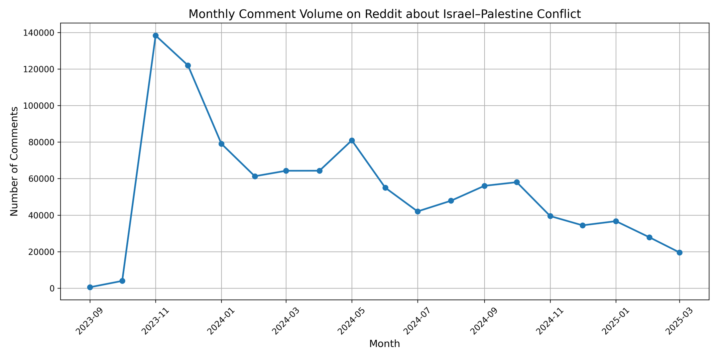
MONTHLY COMMENT VOLUME ON REDDIT ABOUT ISRAEL–PALESTINE CONFLICT
IS7650 SOCIAL MEDIA ANALYSIS
April 07, 2025
PAGE
08

Slide 11
METHODOLOGY
Dataset Source
Name: Daily Public Opinion on Israel-Palestine War – Reddit Comments (From Kaggle)
Time Range: Sep 1, 2023 – July 31, 2024 (Analyze around key events, filter time)
Key Columns: comment_id, self_text, created_time, subreddit, score.
Text Filtering
Remove null or whitespace-only comments
Exclude comments shorter than 20 characters
Text Cleaning
Lowercase text and tokenize each content
Remove stopwords using NLTK, add 'http', 'www', 'amp', 'com' etc. to the stopwords list
Remove punctuations
Lemmatization the part of speech (POS) for each token
Final number of comments used for analysis: 709,940
IS7650 SOCIAL MEDIA ANALYSIS
April 07, 2025
PAGE
09

Slide 12
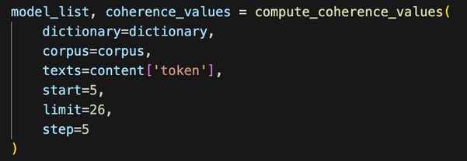
RQ1: LDA Topic Modeling
Model Selection
Constructed a dictionary and corpus (bag-of-words) as model inputs.
Applied LDA topic modeling (Chosen)
Try NMF (high overlapping topices)
Topic Number Evaluation
Used CoherenceModel (C_v metric) to evaluate topic quality.
Tested topic numbers from 5 to 25, scoring at intervals of 5.
Plotted coherence scores to determine the NUM_TOPICS = 15.
Time-based Topic Trend Analysis
Converted the created_time field into monthly periods.
Aggregated topic frequencies by month to build a dataframe.
Visualize monthly topic trends.
IS7650 SOCIAL MEDIA ANALYSIS
April 07, 2025
PAGE
10

Slide 13
RQ1: Topic Modeling Results
Core War-Related Topics
Political & Historical Themes
Emotional & Media Reactions
Topic | Keywords (Simplified) | Label | Core Insights
1 | people, think, say, get, go | General Commentary | lacks focus, reflects casual
2 | israel, palestinian, gaza, government | Core Conflict Events | directly tied to war
3 | support, protest, issue | Protests & Political Action | policy positions, activism, political responses
4 | jew, arab, refugee, return | Religion & Ethnic History | Identity narratives
5 | kill, child, death, murder | Humanitarian Crisis | civilian casualties, especially children
6 | civilian, bomb, hospital | Military Targeting | military actions and civilian harm
7 | america, russia, iran | International Politics | global power dynamics
8 | claim, lie, explain | Debate & Narrative Framing | ideological clashes
9 | muslim, islam, jewish | Religious & Cultural Tensions | eligious-based ideological conflicts
10 | justification, dog, oppressor | Emotional Noise | language with low analytical value
11 | video, news, fake, source | Media & Misinformation | concerns over news authenticity
12 | west bank, law, court | International Law | legal framing
13 | reddit, comment, troll | Platform Dynamics | Reddit behavior
14 | british, massacre, ottoman | Colonial History | historical retrospectives
15 | god, fuck, taliban, beat | Profanity | highly emotional
IS7650 SOCIAL MEDIA ANALYSIS
April 07, 2025
PAGE
11

Slide 14
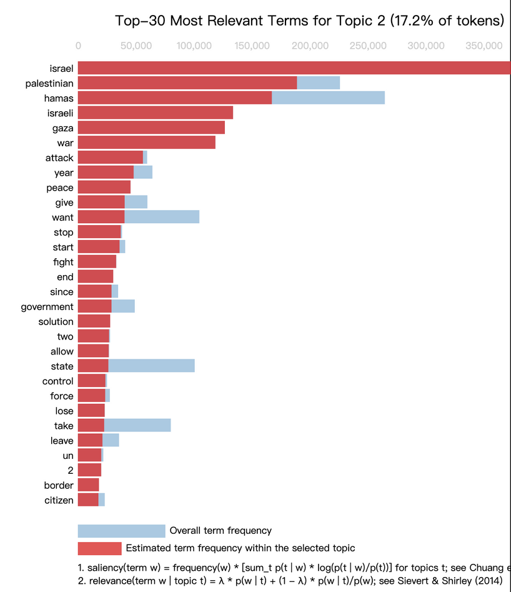
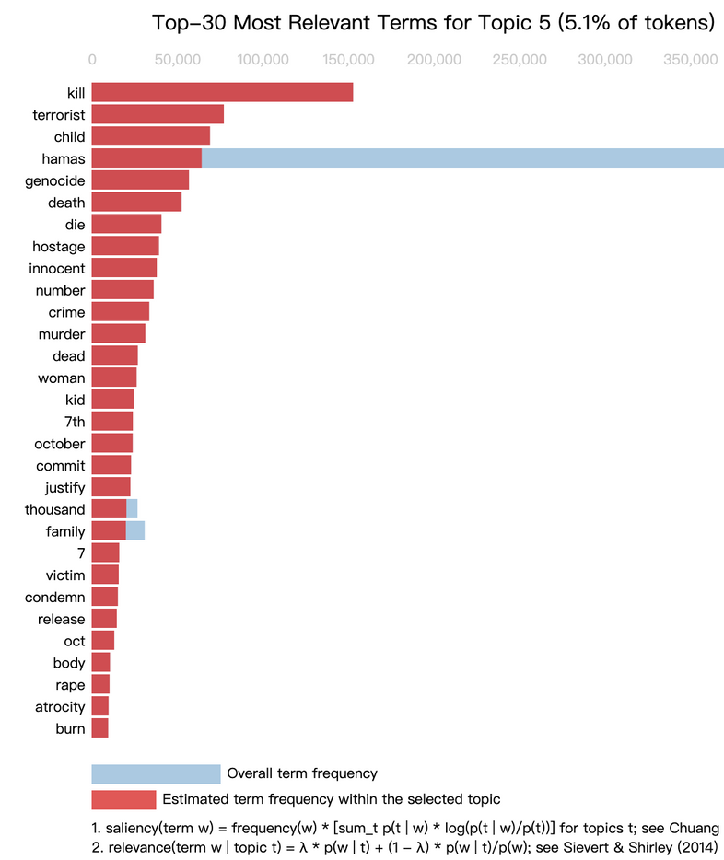
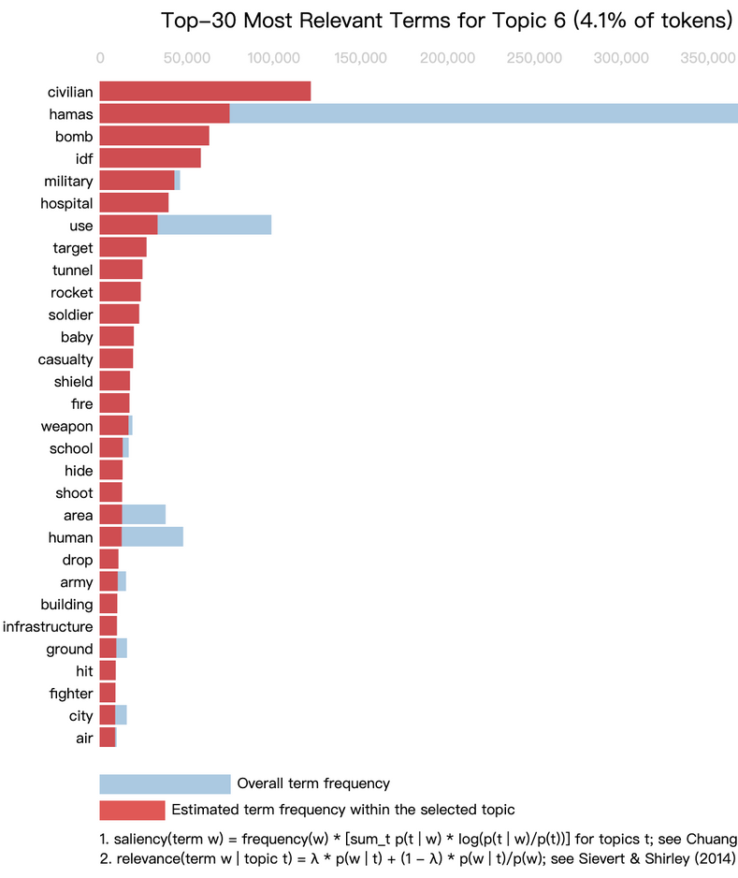
RQ1: Core War-Related Topic
Clear Opposing Forces:
Keywords such as hamas, gaza, bomb, millitary, attack help construct a distinct Israel vs. Hamas conflict frame.
Strong Humanitarian Sentiment:
Terms like child, kill, hospital, woman reflect a clear public sympathy toward victimized groups, highlighting emotional engagement in the discourse.
IS7650 SOCIAL MEDIA ANALYSIS
April 07, 2025
PAGE
12

Slide 15
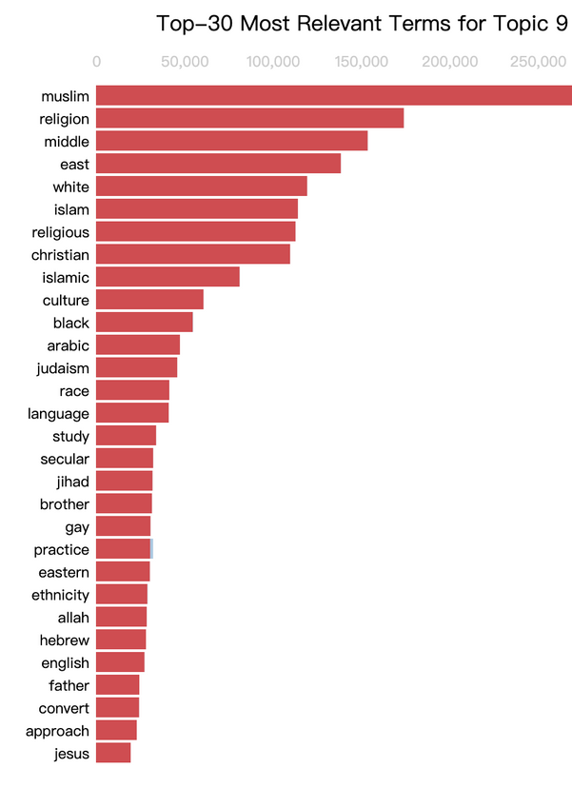
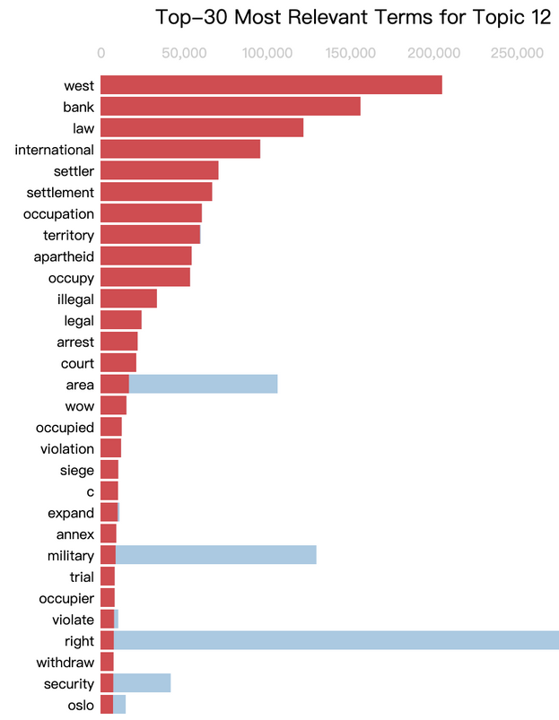
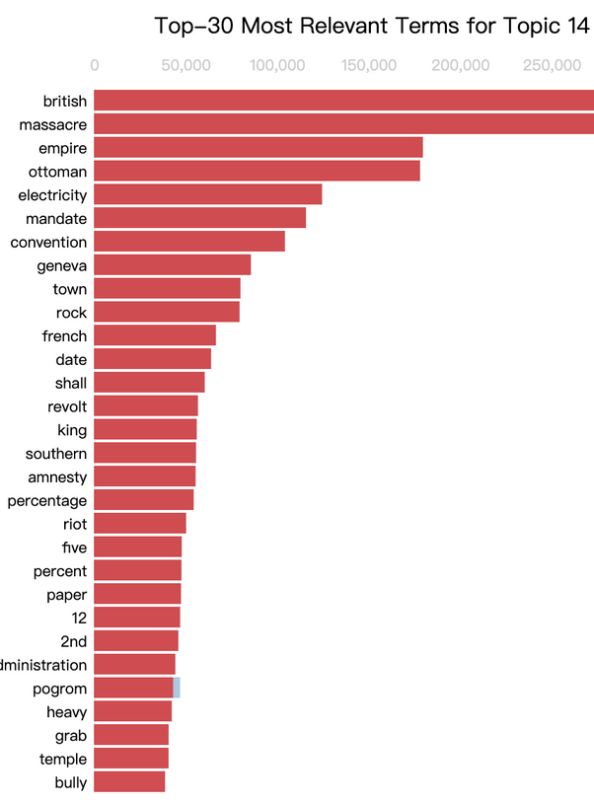
RQ1: Identity, Legality & Religion Topic
Identity & Historical
tokens like ‘refugee,’ ‘colonial,’ and ‘zionist,’ which show how people talk about national roots and belonging.
International Law
words like ‘court,’ ‘law,’ ‘occupation,’ and ‘illegal,’ showing discussions around legal rights and violations.
Religious Themes
tokens like ‘muslim,’ ‘jihad,’ ‘jewish,’ and ‘christian,’ highlighting religious conflict and cultural values.
IS7650 SOCIAL MEDIA ANALYSIS
April 07, 2025
PAGE
13

Slide 16
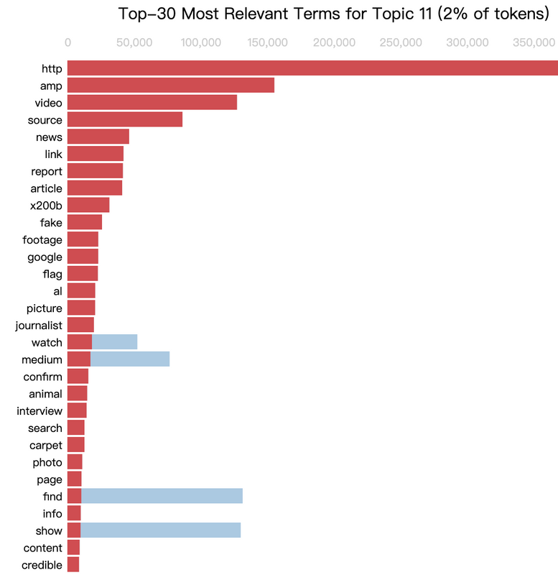
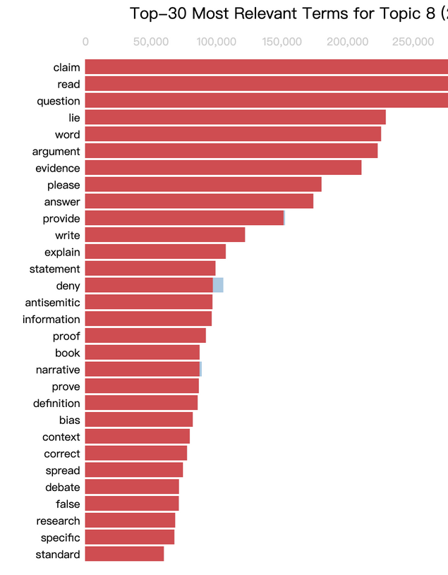
RQ1: Media Dynamics
Misinformation & Media Distrust:
Keywords like fake, video, source, google, lie reflect distrust toward media credibility and potential disinformation
Polarized Opinion:
Words like lie, explain, antisemitic and deney indicate the presence of defensive or accusatory rhetoric, revealing ideological clashes within discussions
IS7650 SOCIAL MEDIA ANALYSIS
April 07, 2025
PAGE
14

Slide 17
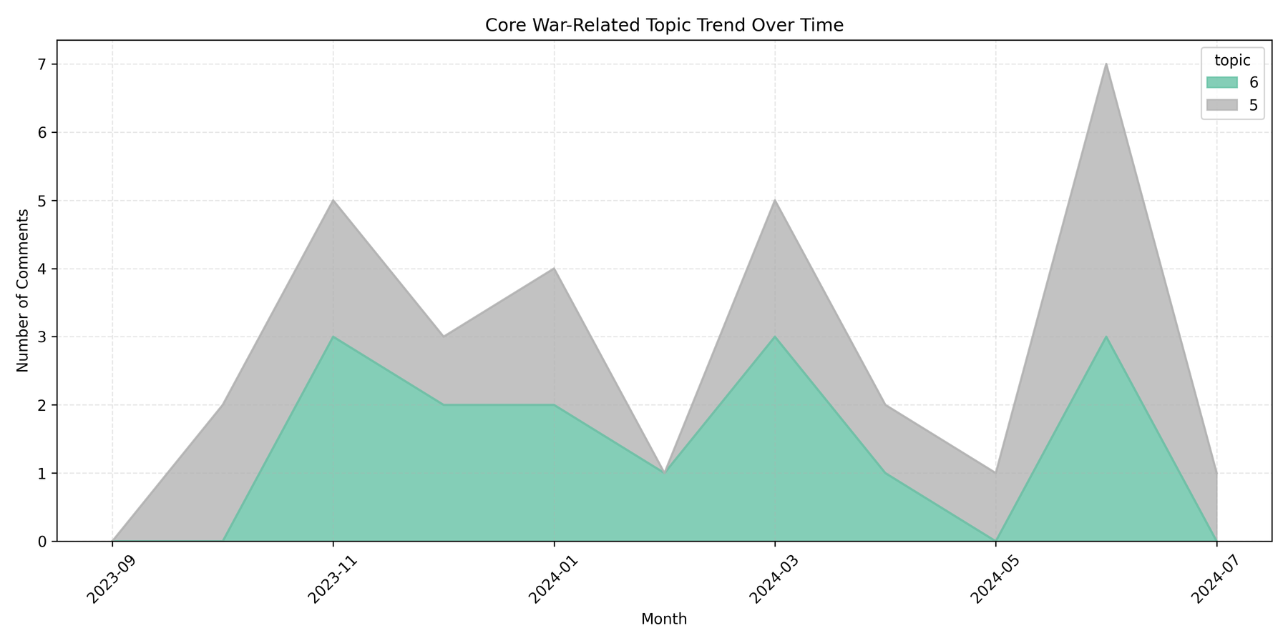
RQ1: Temporal Topic
IS7650 SOCIAL MEDIA ANALYSIS
Resumption of airstrikes after a short ceasefire drew criticism
Cairo ceasefire talks begin; Hamas not involved.
Concern for civilian suffering without political resolution
4 Palestinian factions sign the Beijing Declaration, ending internal divisions.
April 07, 2025
PAGE
15

Slide 18
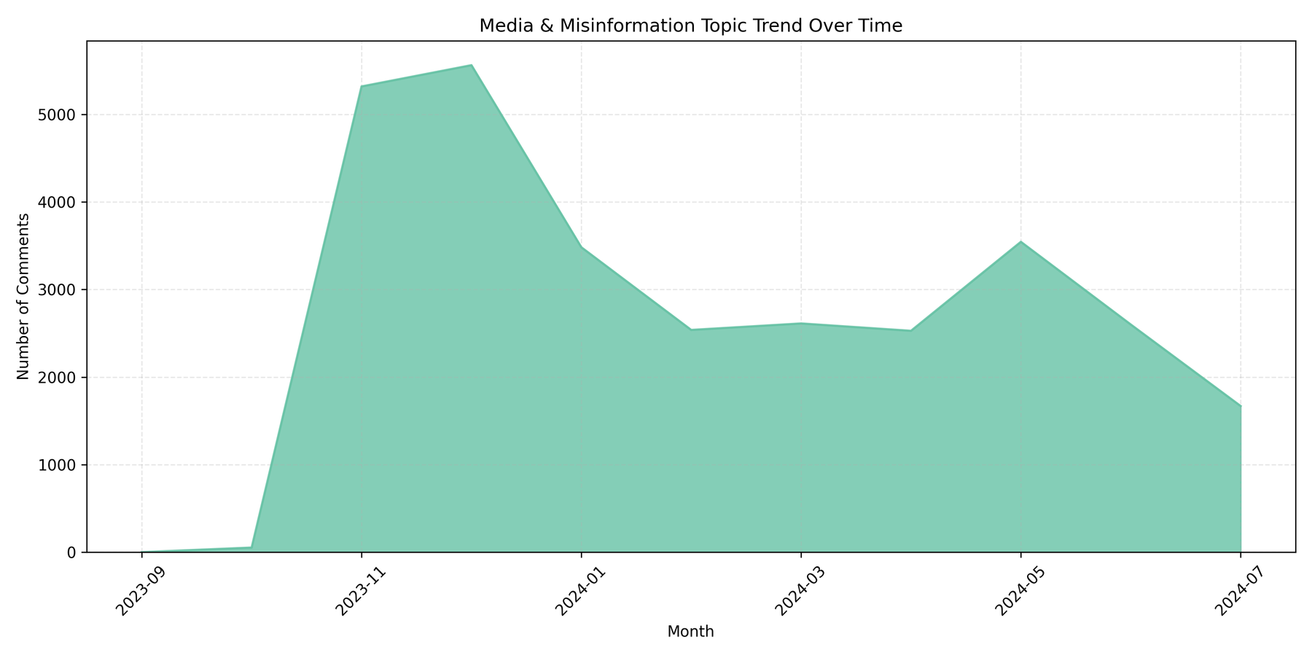
RQ1: Temporal Topic
IS7650 SOCIAL MEDIA ANALYSIS
A sharp rise in topic mentions in November 2023, linked to the conflict outbreak becoming a media focal point. Interest gradually declined, with a minor rebound in May 2024 due to military escalation and controversies. By July, the topic saw a notable drop in attention.
April 07, 2025
PAGE
16

Slide 19
RQ2: Sentiment Analysis
Tool Selection
Utilized SentimentIntensityAnalyzer from the nltk library's VADER tool, designed for social media texts.
VADER employs a predefined sentiment lexicon to assess positive, negative, and neutral sentiments in texts, generating a composite score reflecting the overall sentiment direction.
Data Preparation
Extracted and cleaned text from comments data.
Applied SentimentIntensityAnalyzer to score each comment for positive, negative, neutral sentiments, and a compound score ranging from -1 (very negative) to +1 (very positive).
Sentiment Categorization
Classified comments based on compound scores into negative (≤ -0.5), neutral (-0.5 to 0.5), and positive (≥ 0.5).
IS7650 SOCIAL MEDIA ANALYSIS
April 07, 2025
PAGE
17

Slide 20
RQ2: Sentiment Analysis
Data Analysis
Grouped and counted data by sentiment categories to calculate the percentage distribution of each sentiment across the dataset.
Visualization Techniques
Employed plotly for pie charts and density plots to visualize sentiment distribution and score density, aiding in understanding the nuances and overall trends of sentiments in comments.
Word Cloud Creation
Generated word clouds for each sentiment category using WordCloud library to visually highlight the most frequent words in the comments.
Subforum Sentiment Bias Analysis (Subreddit)
Conducted aggregated sentiment analysis for each subforum to identify forums with significant sentiment biases by calculating average positive and negative sentiment scores, revealing emotional polarity and opinion divides among community members.
IS7650 SOCIAL MEDIA ANALYSIS
April 07, 2025
PAGE
18

Slide 21
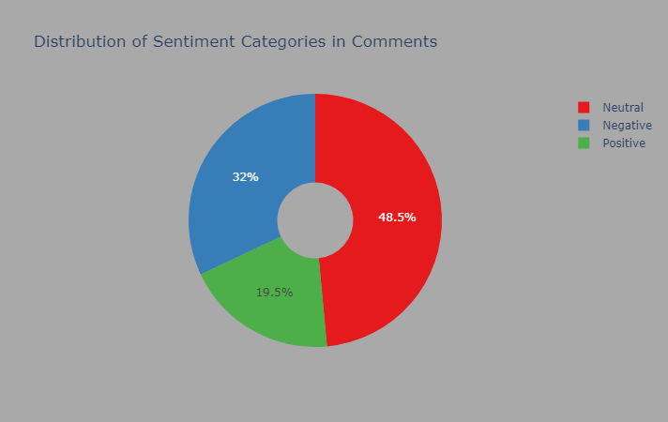
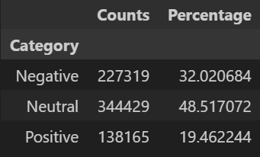
SENTIMENT DISTRIBUTION OVERVIEW
Neutral Comments: 48.5% - Majority of users discuss topics with a neutral tone.
Negative Comments: 32% - Significant portion of comments express negativity.
Positive Comments: 19.5% - Least common, indicating less frequent expressions of positivity in the discussions.
IS7650 SOCIAL MEDIA ANALYSIS
April 07, 2025
PAGE
19

Slide 22
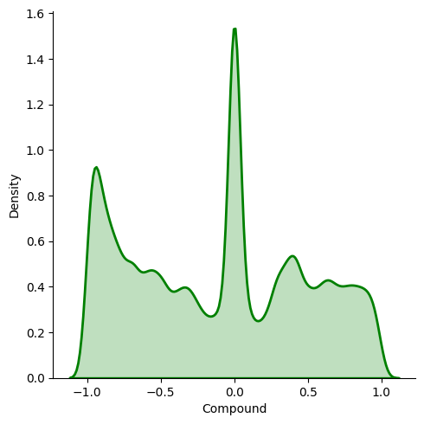
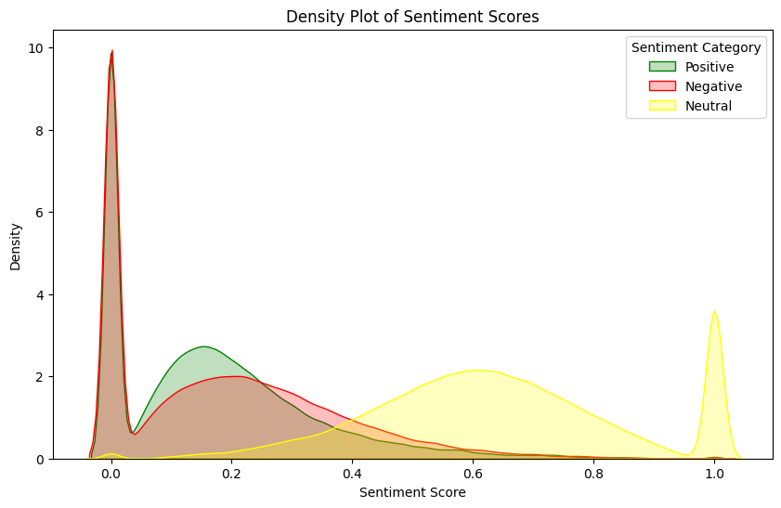
SENTIMENT DENSITY PLOT-SENTIMENT SCORES
Negative Sentiment Peaks:
Primary peak near score 0, indicating prevalent low-intensity negative sentiments.
Secondary peak at score 0.2, signaling clear negative reactions to specific events.
Positive Sentiment Peaks:
Main peak near score 0, showing presence of positive but not wholly positive comments.
Significant secondary peak at score 0.15, highlighting strong positive reactions.
Neutral Sentiment Peak:
Largest peak at score 1.0, representing a substantial portion of completely neutral comments.
IS7650 SOCIAL MEDIA ANALYSIS
Compound Score Trends:
Sharp peak near -1, representing extremely negative comments.
Peak near +1, illustrating extremely positive comments.
Central peak near 0, indicating a balanced emotional expression in many comments.
April 07, 2025
PAGE
20

Slide 23
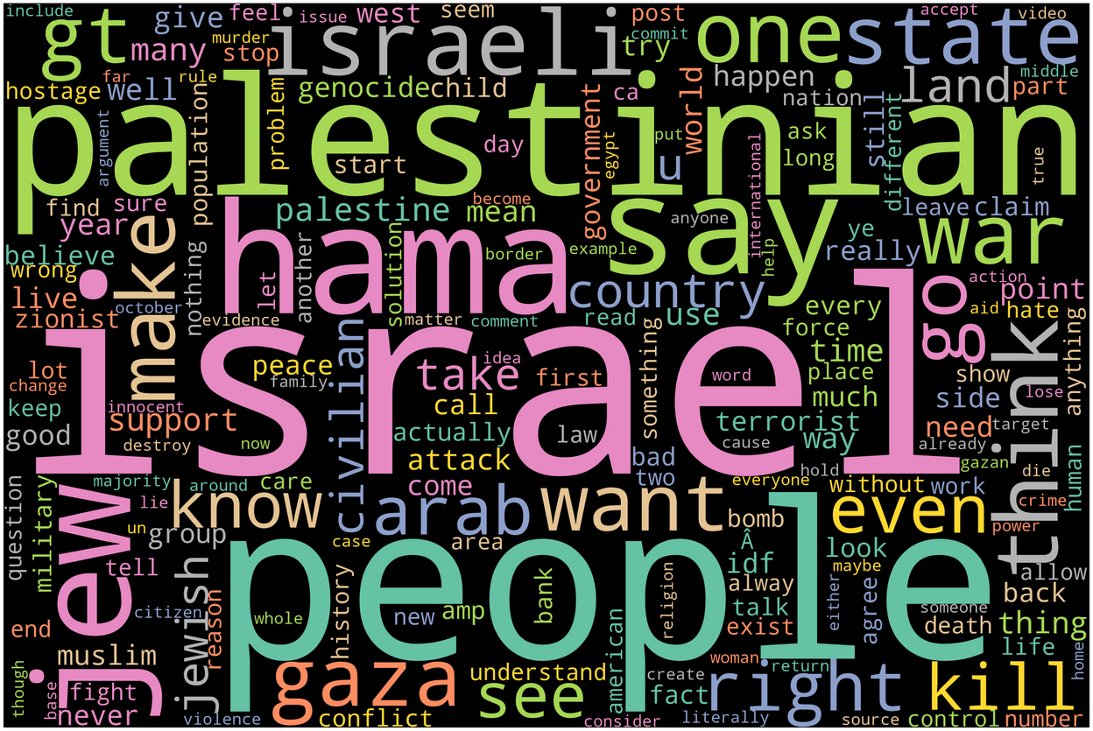
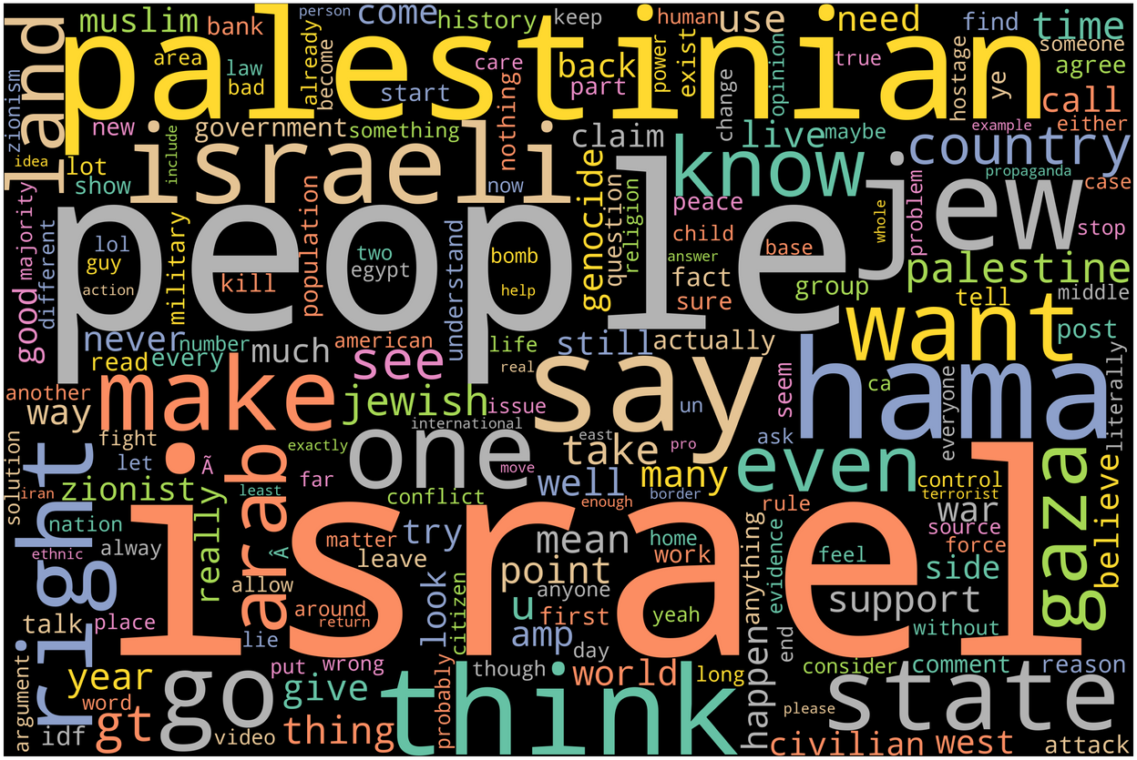
COMMENTS WORDCLOUD
All Comments WordCloud
All Comments WordCloud:
Dominant terms like "Israel," "Palestinian," "people," "war," and "Hamas" suggest a focus on the geopolitical aspects of the discussion.
Words like "say," "think," "want," and "know" indicate active engagement and personal opinions.
IS7650 SOCIAL MEDIA ANALYSIS
Neutral Comments WordCloud:
Features more balanced and possibly factual terms like "state," "government," "country," and "nation."
Includes "people," "Israeli," and "Palestinian," indicating discussions that likely focus on reporting or describing events without explicit sentiment.
Neutral Comments WordCloud
April 07, 2025
PAGE
21

Slide 24
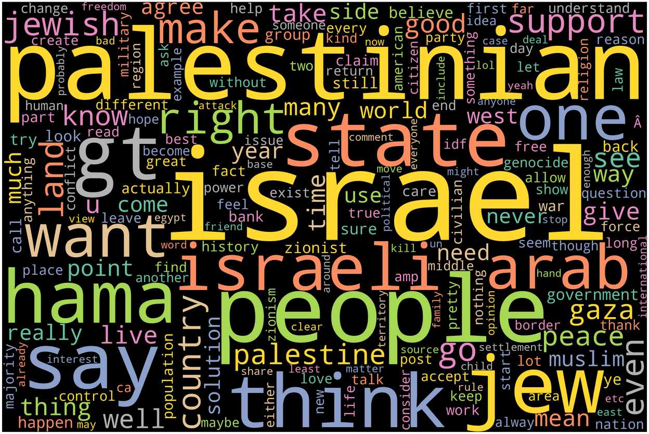
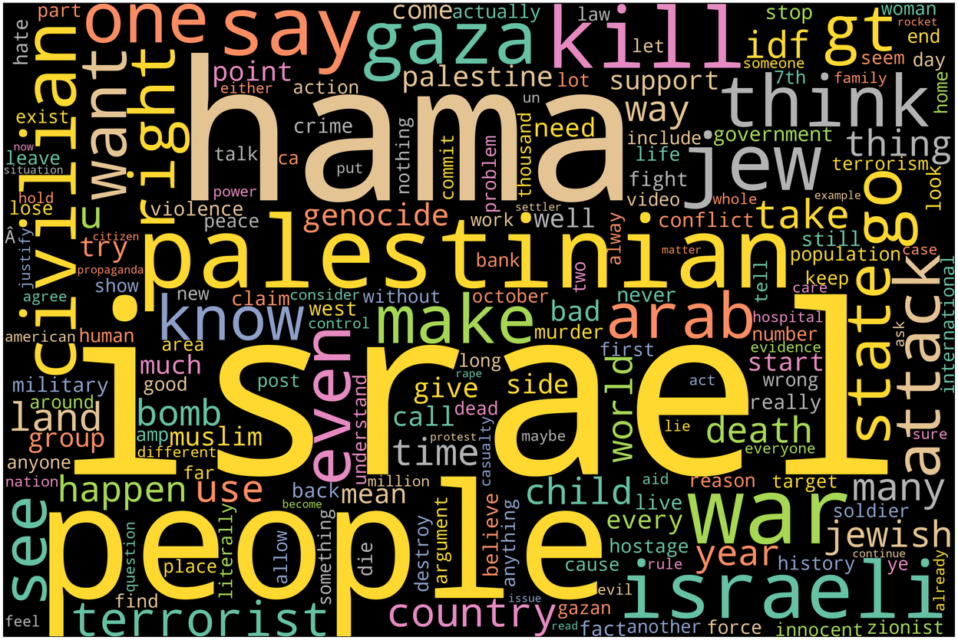
COMMENTS WORDCLOUD
Positive Comments WordCloud:
Contains words like "peace," "support," and "love," highlighting a more hopeful or constructive discourse.
"Help," "care," and "good" suggest positive actions and attitudes towards resolving conflict or supporting people.
Positive Comments WordCloud
IS7650 SOCIAL MEDIA ANALYSIS
Negative Comments WordCloud:
Emphasizes words such as "kill," "war," "death," and "terror," reflecting strong negative emotions associated with conflict.
"Genocide," "fight," and "bomb" further underscore the severity and violence discussed within these comments.
Negative Comments WordCloud
April 07, 2025
PAGE
22

Slide 25
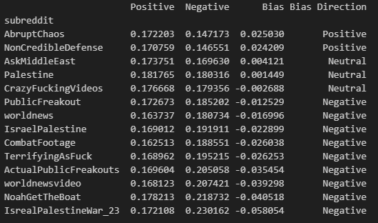
SENTIMENT BIAS OF SUBREDDIT
This table presents the sentiment bias analysis across different subreddits on Reddit.
By calculating the average positive and negative sentiment scores for each subreddit, we have derived a Bias index that measures the overall sentiment orientation of the subreddit content.
For example, a positive bias indicates a tendency toward more positive sentiment comments, whereas a negative bias reflects a prevalence of negative sentiments.
The results show that most subreddits exhibit a negative bias, with only a few showing positive or neutral biases.
IS7650 SOCIAL MEDIA ANALYSIS
Subreddits:
The specialized forums on Reddit where users discuss topics based on shared interests, ranging from science to sports. Each subreddit operates under its own rules and is moderated by community volunteers, making it a unique community within the larger Reddit platform.
April 07, 2025
PAGE
23

Slide 26
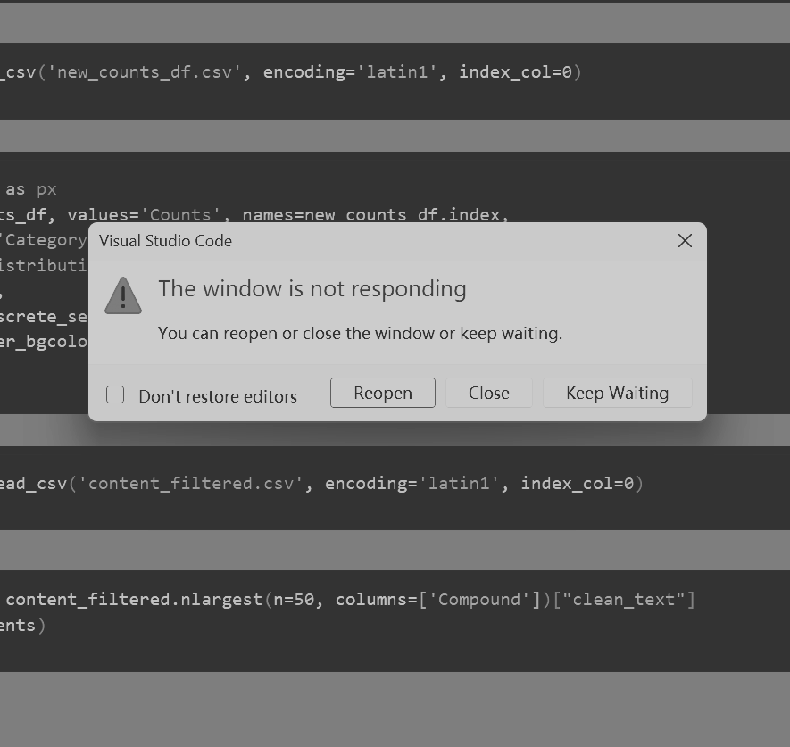

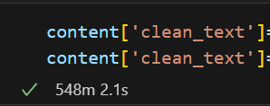
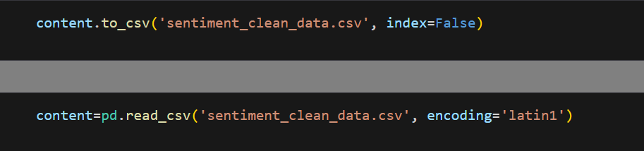
THE BIGGEST CHALLENGE
IS7650 SOCIAL MEDIA ANALYSIS
Too much data leads to some crazy running time and computer overload!
Solution:
The results of every important processing steps would be saved as csv file, like:
April 07, 2025
PAGE
24

Slide 27
REFERENCE
Hatte, S., Madinier, E., & Zhuravskaya, E. (2021). Reading Twitter in the Newsroom: How Social Media Affects Traditional-Media Reporting of Conflicts.Social Science Research Network. https://doi.org/10.2139/SSRN.3845739
Zeitzoff, T. (2017). How Social Media Is Changing Conflict.Journal of Conflict Resolution. https://doi.org/10.1177/0022002717721392
Shamsi, Z. U. H. (2023).Efficacy of Social Media in Wars and Conflicts Brief Review of Russia-Ukraine War. https://doi.org/10.58329/criss.v2i4.66
Hunter, L. Y., & Biglaiser, G. (2022).The Effects of Social Media, Elites, and Political Polarization on Civil Conflict. https://doi.org/10.1080/1057610x.2022.2163461
Contemporary Trends in Conflict and Communication. (2022). https://doi.org/10.1515/9783110687262
Silva, D., Silva, R. M. A. da, Lima, P. F., Batista, J. E., & Júnior, S. F. A. X. (2024). Reddit comment analysis: sentiment prediction and topic modeling using VADER and BERTopic.Socioeconomic Analytics. https://doi.org/10.51359/2965-4661.2024.265074
Aggarwal, A., Gola, B., & Sankla, T. (2021).Data Mining and Analysis of Reddit User Data. https://doi.org/10.1007/978-981-33-6691-6_24
McGeary, T. (2023).A Descriptive Analysis of Reddit Comments Using Data Analytics Approach. https://doi.org/10.1007/978-981-19-7513-4_16
Raina, P. (2022). Sentiment analysis on news articles.International Journal for Innovative Engineering and Management Research. https://doi.org/10.48047/ijiemr/v11/i06/20
Ajitha, P., Sivasangari, A., Rajkumar, R. I., & Poonguzhali, S. (2021). Design of text sentiment analysis tool using feature extraction based on fusing machine learning algorithms.Journal of Intelligent and Fuzzy Systems. https://doi.org/10.3233/JIFS-189478
Sun, J., Wang, M., Ren, D., & Chen, D. (2024). Research and Application of Text-Based Sentiment Analytics.Frontiers in Artificial Intelligence and Applications. https://doi.org/10.3233/faia241391
Le, T. (2019). A Hybrid Method for Text-Based Sentiment Analysis.International Conference on Computational Science. https://doi.org/10.1109/CSCI49370.2019.00260

Slide 28
REFERENCE
Sentiment Analysis Using Text Mining: A Survey. (2023).International Research Journal Of Modernization In Engineering Technology And Science. https://doi.org/10.56726/irjmets43989
Chen, J. (2024).Sentiment Analysis of Translated Texts Combined with Artificial Intelligence and Improvement of Machine Translation. https://doi.org/10.1109/telepe64216.2024.00161
Saraf, A. (2024). Analysing the Sentiments using Natural Language Processing.International Journal for Research in Applied Science and Engineering Technology. https://doi.org/10.22214/ijraset.2024.58091
Турута, О., & Штанько, О. (2024). Дослідження методів оцінки сентименту діалогових повідомлень.Ренессанс в Парадигме Новаций Образования и Технологий в XXI Веке. https://doi.org/10.30837/iyf.iis.2024.418
Jiao, S. (2025). Research on text sentiment analysis in natural language processing.IET Conference Proceedings.https://doi.org/10.1049/icp.2024.3977
Zhang, Y., Mao, W., & Lin, J. (2017).Modeling Topic Evolution in Social Media Short Texts. https://doi.org/10.1109/ICBK.2017.39
Zhang, Y., Mao, W., & Zeng, D. (2017). Topic evolution modeling in social media short texts based on recurrent semantic dependent CRP.Intelligence and Security Informatics. https://doi.org/10.1109/ISI.2017.8004885
Deng, Q., Cai, G., Zhang, H., Liu, Y., Huang, L., & Sun, F. (2018). Enhancing situation awareness of public safety events by visualizing topic evolution using social media.International Conference on Digital Government Research. https://doi.org/10.1145/3209281.3209378
Fu, X., Wang, Y., Li, M., Dou, M., Qiao, M., & Hu, K. (2020). Community Evolutional Network for Situation Awareness Using Social Media.IEEE Access. https://doi.org/10.1109/ACCESS.2020.2976108
Deng, Z., Ma, R., Wu, M., & Evans, R. (2023). Netizens’ concerns during COVID-19: a topic evolution analysis of Chinese social media platforms.Kybernetes. https://doi.org/10.1108/k-04-2023-0583
Fu, P., Lin, Z., Lin, H., Yuan, F., Wang, W., & Meng, D. (2016).Quantifying the Effect of Sentiment on Topic Evolution in Chinese Microblog. https://doi.org/10.1007/978-3-319-45814-4_43
Bide, P., Magotra, V., Jain, J., Rao, P., & Jain, K. (2021). Comprehensive Survey on Techniques of Topic Evolution Mining.International Conference on Communication and Electronics Systems. https://doi.org/10.1109/ICCES51350.2021.9488965

Slide 29
REFERENCE
Zhou, H., Yu, H., Hu, R., & Hu, J. (2017). A survey on trends of cross-media topic evolution map.Knowledge Based Systems. https://doi.org/10.1016/J.KNOSYS.2017.03.009
The Background and Key Issues of the Israel-Hamas War. (2024).Jung-Dong Jeongchi Sahoe Yeon’gu. https://doi.org/10.52891/jmea.2024.23.2.1
Tengah, K. A. (2022).The Gaza Strip and the Israel-Hamas Conflict: From 2008 until Nowadays. https://doi.org/10.54145/actamn.58.15
Asangausung, O. S., Abang, T. A., Udousoro, T. E., Oko, N. I., & Okon, G. E. (2024). The Israel-Hamas Armed Conflict in the Middle East: A Sociological Lens.AKSU Journal of Administration and Corporate Governance. https://doi.org/10.61090/aksujacog.2024.043
Zhu, J., & Liu, Y. (2024). The Representation of Israel-Hamas Conflict in the American and Chinese News Coverage: A Corpus-assisted Comparative Critical Discourse Analysis.International Journal of Social Sciences and Public Administration. https://doi.org/10.62051/ijsspa.v4n2.49
Jha, A. (2024). The 2023 Israel-Hamas Conflict: Geopolitical Ripples from the Middle East to the Indo-Pacific.International Journal of Politics and Media. https://doi.org/10.26524/ijpm.3.10
Heinze, E. A. (2024). International Law, Self-Defense, and the Israel-Hamas Conflict.Parameters. https://doi.org/10.55540/0031-1723.3273
Gomes, F. D., & Santos, R. C. C. dos. (2024).Guerra israel e hamas: apontamentos das violações do direito internacional humanitário - convenção de genebra e protocolos. https://doi.org/10.62140/fgrs5182024
Abumbe, G. T., Terhile, A., & Helen, D. C. (2024). Hamas-Israel Conflicts In Gaza And Its Implications For Middle East Stability.Global Journal of Social Sciences. https://doi.org/10.4314/gjss.v23i1.13
From Echo Chambers to Resonance Chambers: How Offline Political Events Enter and Are Amplified In Online Networks. (2022). https://doi.org/10.31234/osf.io/vzu4q
Mora-Cantallops, M., Sánchez-Alonso, S., Visvizi, A., & Visvizi, A. (2021). The influence of external political events on social networks: the case of the Brexit Twitter Network.Journal of Ambient Intelligence and Humanized Computing. https://doi.org/10.1007/S12652-019-01273-7
Calisir, E., & Brambilla, M. (2019). Characterizing Long-Running Political Phenomena on Social Media.arXiv: Computers and Society.
Hussain, M. K. I., Farooq, H., & Iqbal, D. N. (2023).A Qualitative Study of Exploring the Impact of Social Media on Political Participation. https://doi.org/10.55529/jmcc.36.11.21
Sjoraida, D. F., Guna, B. W. K., Nungraha, A. R., Amri, M., Santosa, T. A., & Suar, A. (2024).Exploring the Impact of Social Media on Political Participation: A Review of Empirical Studies. https://doi.org/10.31004/innovative.v4i3.10497

Slide 30
REFERENCE
Camara, A. (2024). Re-Examining the Impact of Social Media on Political Discourse: An Elaboration of Likelihood Model Analysis of Nigeria’s 2019 Presidential Election.Southwestern Mass Communication Journal. https://doi.org/10.58997/wpgnf936
Arsyad, A., Dzaljad, R. G., Nurmiarani, M., & Rantona, S. (2024). Media Sosial sebagai Agen Transformasi Politik: Analisis Pengaruh terhadap Proses Komunikasi Politik.Jurnal Pendidikan Dan Ilmu Sosial. https://doi.org/10.54066/jupendis.v2i2.1593
Intyaswati, D. (2023). The Influence of Social Media on Online Political Participation among College Students: Mediation of Political Talks.The Southern Speech Journal. https://doi.org/10.1080/1041794x.2023.2165703
Intyaswati, D., & Fairuzza, M. (2023). The Influence of Social Media on Online Political Participation among College Students: Mediation of Political Talks.The Southern Communication Journal. https://doi.org/10.1080/1041794X.2023.2165703

Slide 31
IS7650 SOCIAL MEDIA ANALYSIS
Q&A
ZHAO ZIQING G2404735C
CHEN ZIQING G2404783K
April 07, 2025
PAGE
25

